Slide 1
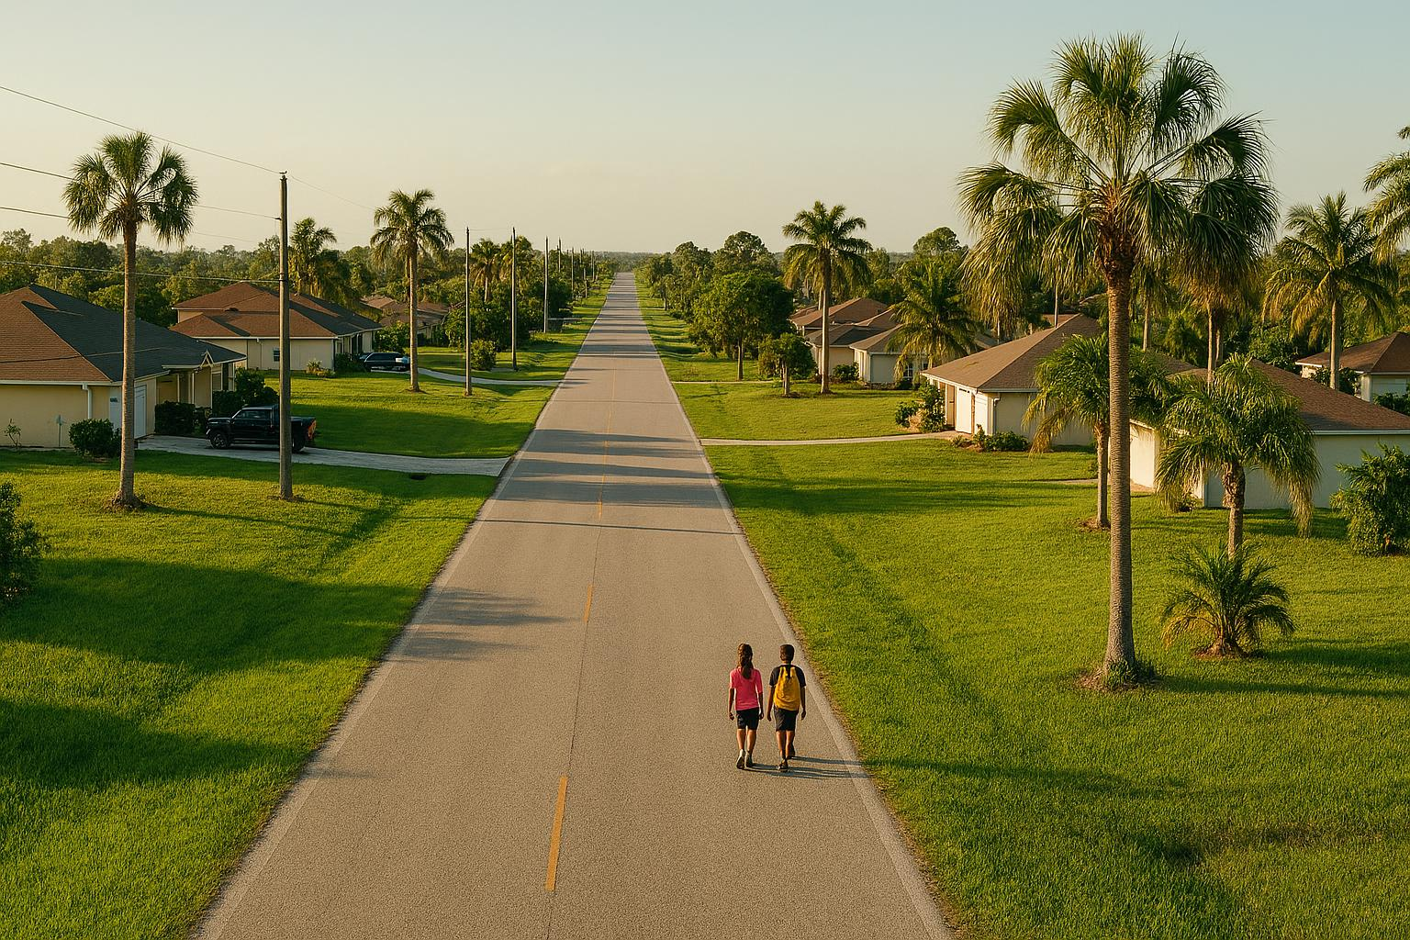

SIDEWALK REQUEST
East Side of Sara Ave N | Between 5th St W & 6th St W
Lehigh Acres, FL | Lee County BPAC
Presented to the Bicycle/Pedestrian Advisory Committee

Slide 2
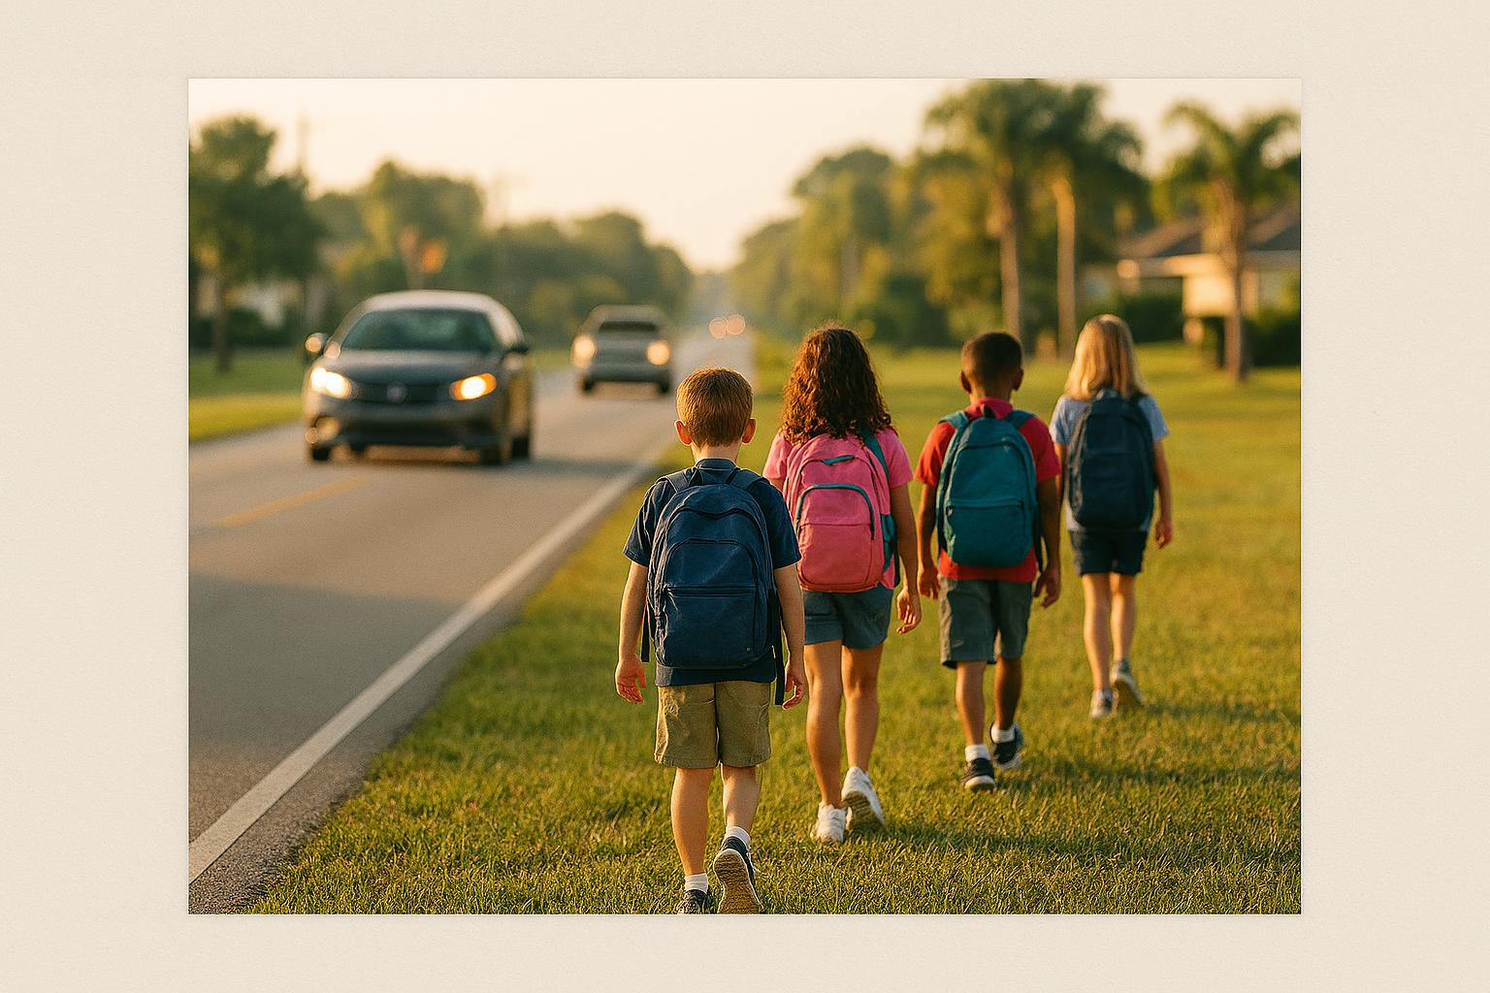



🔴 Wink News | Parents in Lee County Call for Safety Improvements at Sunshine Elementary Drop-Off | Lee County | winknews.com
SUNSHINE ELEMENTARY SCHOOL
The Largest Elementary
in the District
601 Sara Ave N, Lehigh Acres, FL 33971
1,390
825
TOTAL STUDENTS
Parent Drop-Off
No Sidewalk on the East Side of Sara Ave N
Students must share the roadway with vehicles, creating dangerous conditions daily during drop-off and pick-up.

Slide 3




WHY THE SIDEWALK COMES FIRST
Each safety improvement depends on the one before it
STEP 1
STEP 2
STEP 3
Sidewalk
Crosswalk
School Zone Signs
A 5-foot concrete sidewalk on the east side of Sara Ave N between 5th St W and 6th St W provides a safe, separated path for students.
A crosswalk will only be considered once a sidewalk is in place. The sidewalk is the prerequisite for a marked crossing.
School zone signage requires a crosswalk. Without the sidewalk, neither the crosswalk nor the signs can be installed.
The sidewalk is the critical first step to unlocking crosswalks and school zone protections for 1,390 students.

Slide 4
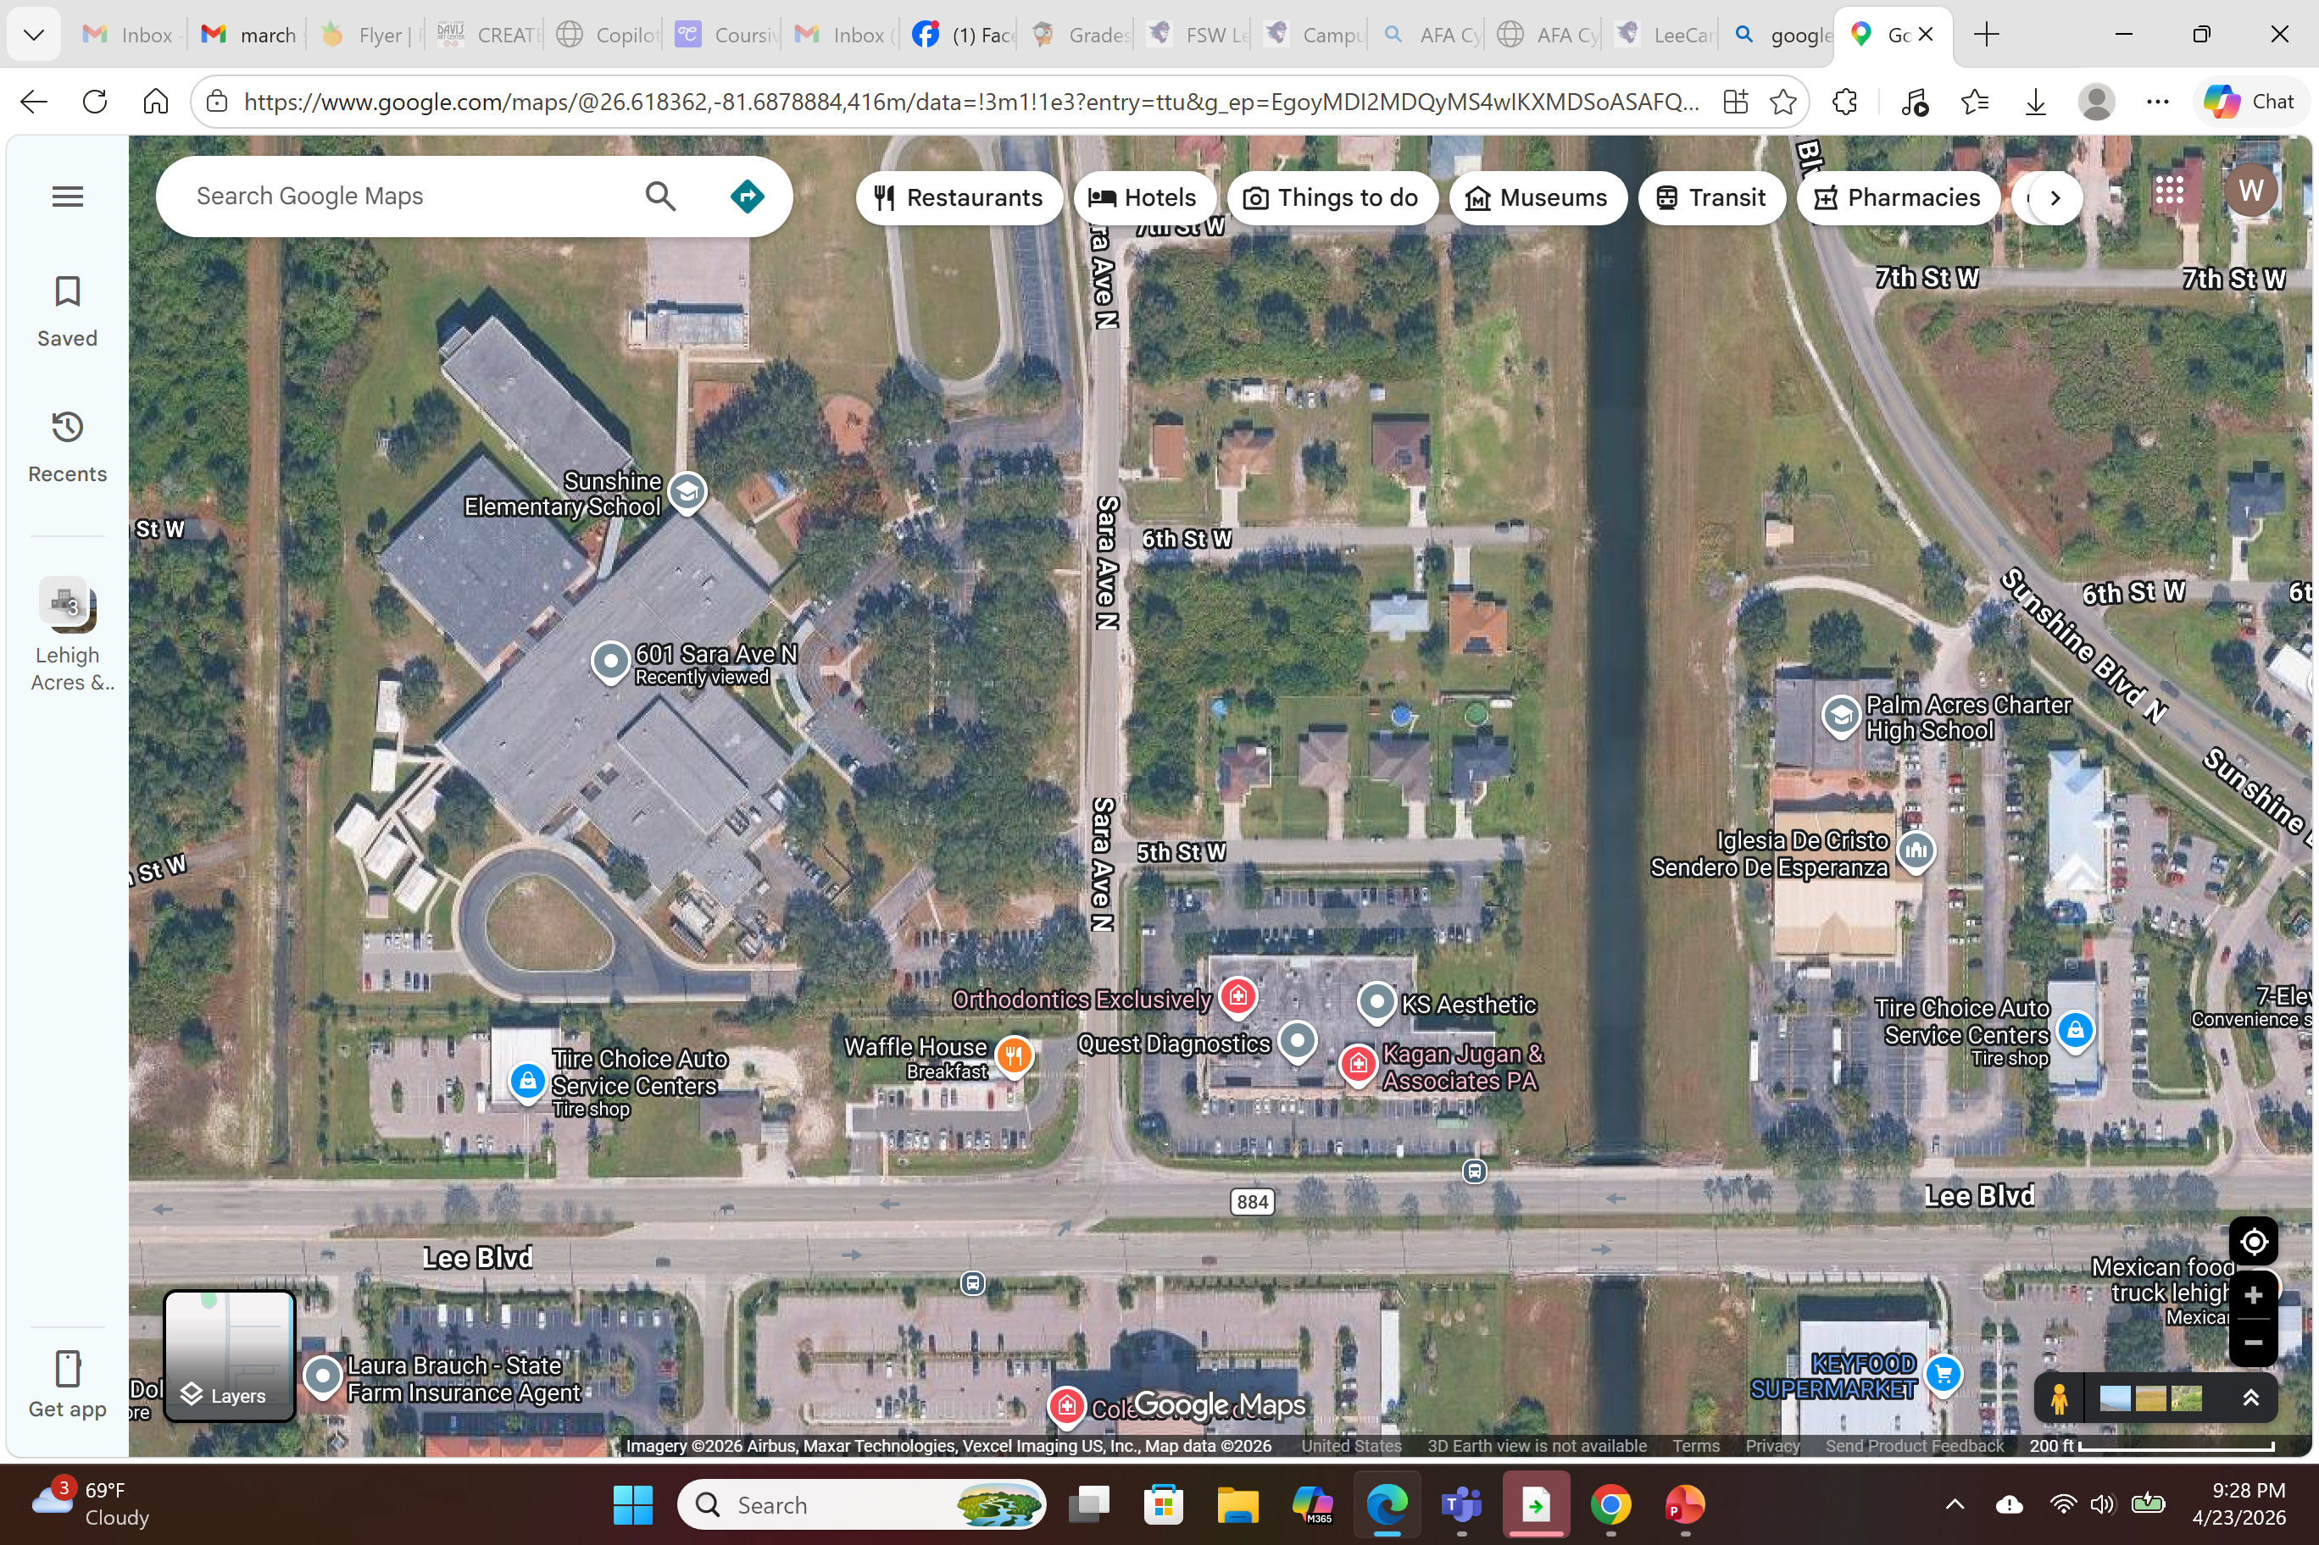




PROJECT LOCATION
Where the Sidewalk Is Needed
Street
East side of Sara Ave N
Limits
Between 5th St W and 6th St W
Adjacent School
Sunshine Elementary | 601 Sara Ave N
Jurisdiction
Unincorporated Lee County

Slide 5


CURRENT CONDITIONS
Daily Safety Risks Without a Sidewalk
No Protected Walking Path
High Vehicle Volume During School Hours
Children walk in the road or on unpaved shoulders alongside moving vehicles.
825 parent drop-off or pick-up vehicles create congested, dangerous conditions twice daily.
Children Exposed to Traffic
No Crosswalk or School Zone Signs Possible
Students on foot have no separation from cars, trucks, and buses on Sara Ave N.
Without a sidewalk, crosswalks and school zone signage cannot be installed.
Lee County Context
Lee County Commissioners authorized school zone speed cameras in Feb 2025 — recognizing that drivers routinely exceed 15 mph limits near schools.
Florida's Safe Routes to School program funds infrastructure that removes barriers to walking and biking safely to school.

Slide 6
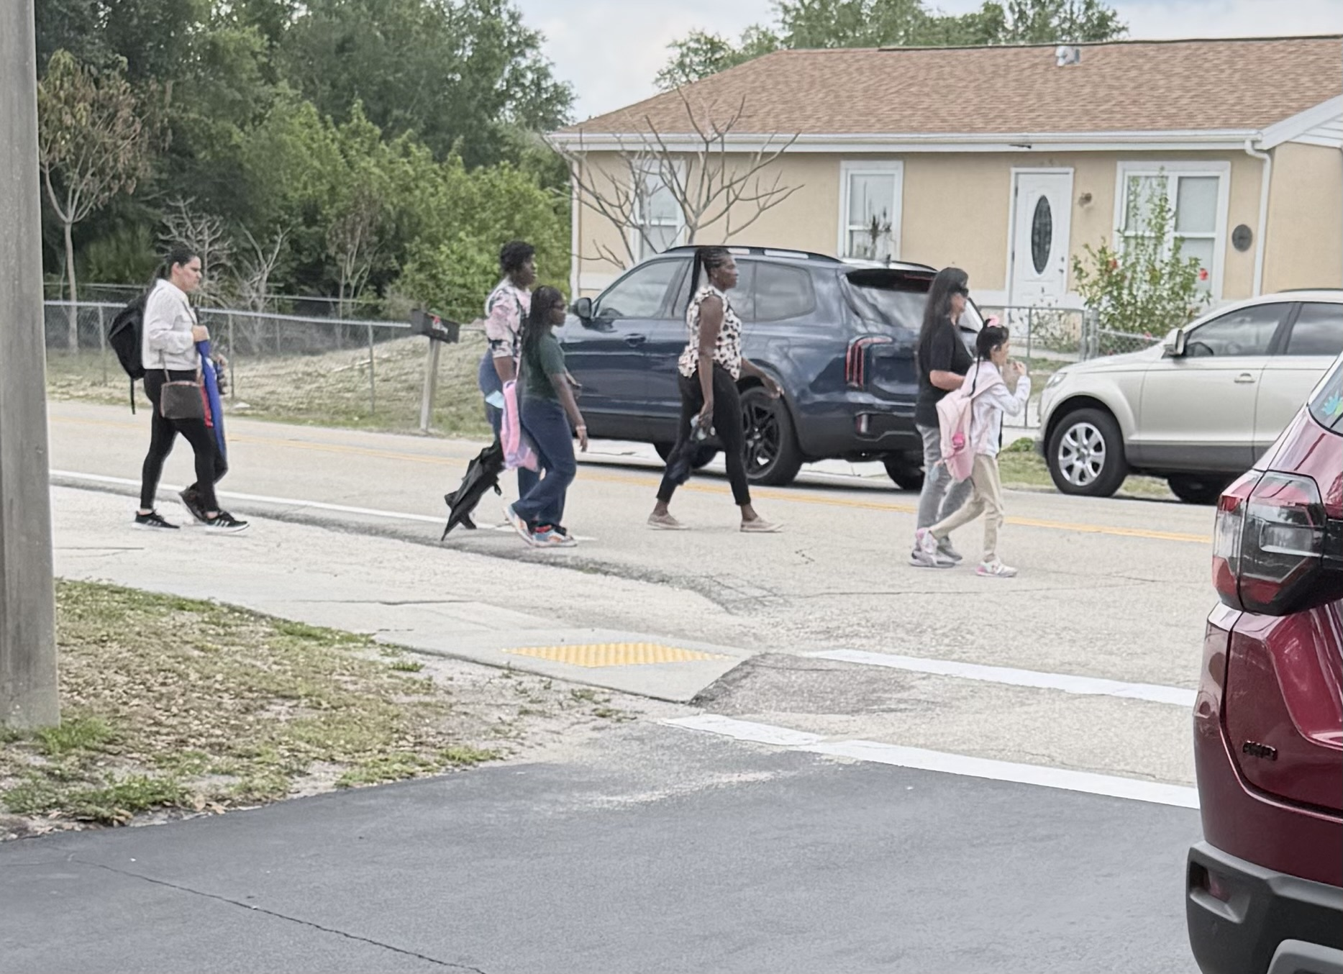
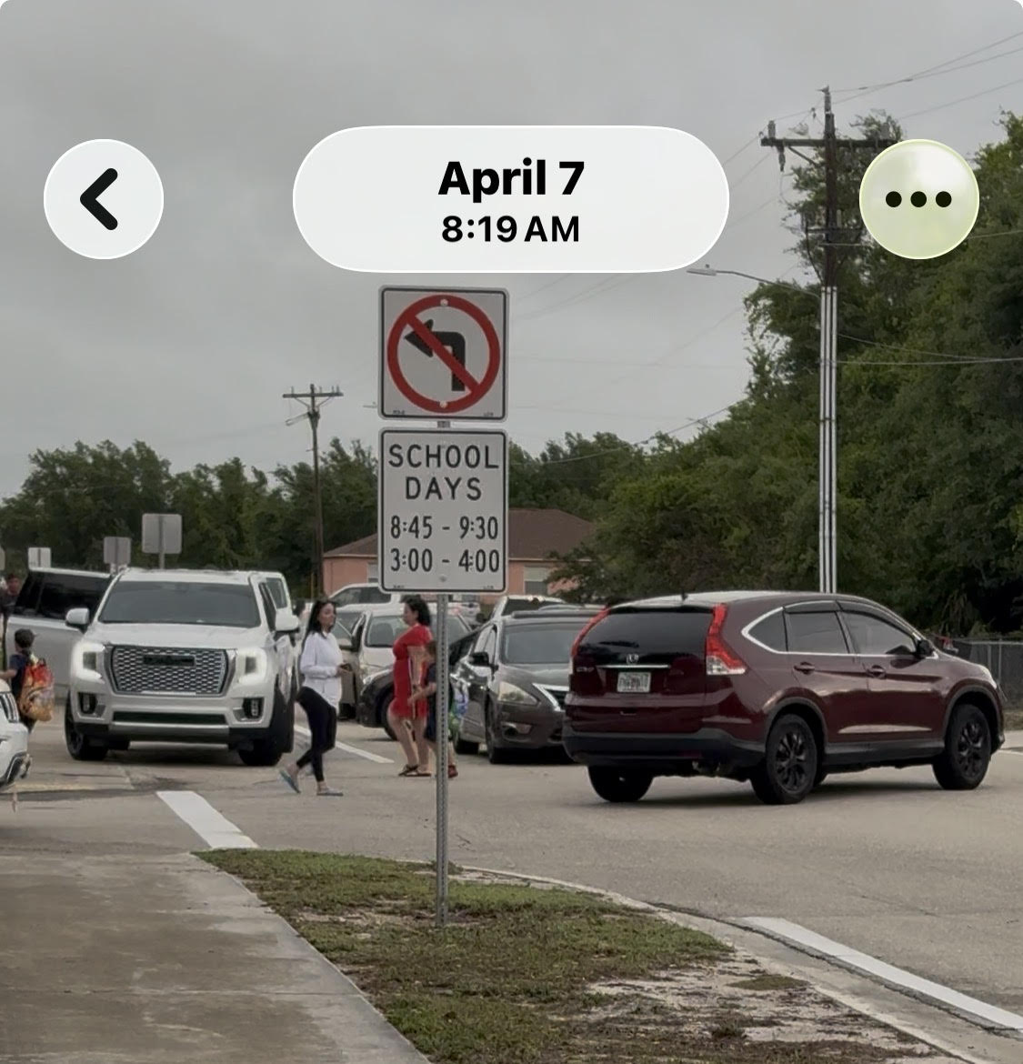
See the Danger for Yourself
VISUAL EVIDENCE
◄ WEST
SARA AVE N
⚠
EAST ►
PROJECTED
SCHOOL ZONE
PROJECTED
SCHOOL ZONE
6th St W
✓
⬅ PROJECTED CROSSWALK
SIDEWALK
EXISTS
⚠
SUNSHINE
ELEMENTARY
⚠
CONFLICT ZONE
⬅ MISSING
SIDEWALK
SEGMENT
⚠
⚠
NO
SIDEWALK
⚠
✓
5th St W
⬅ PROJECTED CROSSWALK
⚠
SIDEWALKS
ON BOTH SIDES
LEGEND:
Lee Blvd
◄
►
PROJECTED
SCHOOL ZONE
⚠
No Sidewalk (Danger)
Vehicle Traffic
Children in Road
Projected Crosswalk
This is not a theoretical risk — it is an active safety exposure on a county-maintained road.

Slide 7
LOCAL DATA — SARA AVE N
Sara Ave N — Year by Year
2023
5
Crash Reports
Near Sunshine Elementary
3 MVA
Lehigh Fire Dept
2024
5
Crash Reports
1
Arrest
1 MVA
Lehigh Fire Dept
2025
45
Enforcement Actions
5 Citations · 38 Warnings · 2 Parking
1
Arrest
1 MVA
Lehigh Fire Dept
2026
71
Enforcement Actions
51 Citations · 20 Warnings (thru May)
2 Crash · 1 Arrest
12 Crash Reports · 6 MVA (Lehigh Fire Dept) · 3 Arrests · 116 Enforcement Actions
This is a systemic safety crisis — not a parenting problem.
BPAC SCORING IMPACT This data feeds the Crash/Roadway Data category — worth up to 21 additional points (12 pts crash history + 5 pts AADT + 4 pts speed). 11 crashes in 4 years strongly supports maximum crash scoring. Lehigh Fire Dept responded to 6 MVAs on Sara Ave N (2022: 1, 2023: 3, 2024: 1, 2025: 1).

Slide 8
THE DATA BEHIND THE DANGER
Traffic Fatalities Near Schools Without Traffic Control
65%
Pedestrian Deaths Where No Sidewalk Exists
1,000+
School-Zone Crash Deaths (2013–2022)
Nearly two-thirds of all U.S. pedestrian fatalities in 2023 occurred in locations without a sidewalk.
Over 1,000 people died in school-transportation crashes over a decade; 38% were pedestrians.
59%
Of Schools Lack Crossing Guards
3rd
Florida Ranks 3rd Worst in the U.S.
Only 41% of U.S. public schools have crossing guards on surrounding streets, leaving critical safety gaps.
Florida has the 3rd highest pedestrian fatality rate nationally; 54% of drivers admit to speeding in school zones.
Sources
GHSA Pedestrian Traffic Fatalities by State, 2024 Data | NHTSA School-Transportation Crashes, 2024 | NCES School Survey, 2025 | Altumint Florida Road Safety Report
Sunshine Elementary students face these same national and statewide risks every day without a sidewalk on Sara Ave N.

Slide 9
LIABILITY ASSESSMENT
Known Risk + No Intervention
= Liability Exposure
County Owns the Road
Sara Ave N is a Lee County–maintained road under county jurisdiction and responsibility.
Known Student Traffic
1,390 students at Sunshine Elementary rely on Sara Ave N daily. Pedestrian activity is documented and predictable.
No Safe Infrastructure
No sidewalk, no crosswalk, no school zone signs. Zero protective infrastructure has been provided.
Florida Statutes recognize and prioritize safe pedestrian access near schools.
F.S. § 1006.23 – Hazardous Walking Conditions: No sidewalk = hazardous condition. Government entities must correct hazards within a reasonable time.
F.S. § 316.1895 – School Speed Zones: Counties must install and maintain traffic and pedestrian control devices near all schools.
F.S. § 335.065 – Pedestrian Ways: Pedestrian ways shall be given full consideration in transportation planning, especially within 1 mile of urban areas.
F.S. § 335.066 – Safe Paths to Schools: FDOT program for planning and constructing safe pedestrian routes from neighborhoods to schools.
F.S. § 336.045 – Minimum Standards: FDOT sets uniform minimum standards for design and maintenance of sidewalks, crosswalks, and curb ramps.
This is a known risk with foreseeable harm. Inaction itself becomes the liability.

Slide 10
STATE LAW • FLORIDA STATUTE
F.S. § 1006.23 — Hazardous Walking Conditions
Applies to all public elementary school students through grade 6. District school boards must provide transportation when hazardous conditions exist.
Walkways Parallel to Road
Minimum 4-foot walking area adjacent to road required, so students do not walk on the road surface
55 mph roads: Walking area must be set back at least 3 feet from the road edge
Exceptions: residential areas with little transient traffic, roads under 180 vehicles/hr per direction, or residential roads posted 30 mph or less.
Walkways Perpendicular to Road
Uncontrolled crossings: Hazardous if traffic exceeds 360 vehicles/hr per direction with no crossing guard or traffic signal
Controlled crossings: Hazardous if total traffic exceeds 4,000 vehicles/hr at stop-sign-controlled intersections without crossing guards
Traffic volume determined by the most current traffic engineering study conducted by a state or local governmental agency.
Government Obligation
Upon determination of a hazardous condition, the governmental entity with jurisdiction must respond with a correction plan and projected completion date. State transportation funds are allocated for student busing until the hazard is corrected.
2025 Legislative Update — CS for CS for SB 650
Sponsored by Senators Leek and Rouson. Revises the criteria determining hazardous walking conditions for public school students. Referred through the Committee on Transportation and the Appropriations Committee on Pre-K – 12 Education.

Slide 11
THE COST OF ACTION VS. INACTION
A Sidewalk Costs Far Less Than a Single Tragedy
~$25,000
$12.5M+
Estimated Cost of One Block of Sidewalk
vs.
Federal Value of a Single Life Lost
A 5-foot concrete sidewalk on Sara Ave N between 5th & 6th Street is approximately 2,500 sq ft at $6–$12/sq ft (Florida avg.).
A one-time investment that protects 1,390 students every school day for decades.
Cost per student protected: under $20 annually over lifespan
The U.S. DOT values a statistical life at $12.5 million — not including emergency response, legal costs, or the immeasurable grief to a family and community.
Cost per student protected: under $20 annually over lifespan
No dollar figure can capture the true cost of losing a child.
What If the Community Helped Fund a Portion?
If raising a percentage of the cost would accelerate approval, the community is ready to explore that conversation. Whether through local fundraising, PTA contributions, business sponsorships, or matching grants — families are willing to invest in their children’s safety.
What would it take to move this project forward faster?

Slide 12
BPAC PRIORITY SCORING
Sara Ave N Sidewalk Qualifies Across Every Category
CATEGORY
OUR QUALIFICATION & POINT BREAKDOWN
POINTS
Title I Elementary School
Sunshine Elementary — Public school (10) + Elementary level (4)
14 pts
LeeTran Bus Route
Public bus stop within one block — Transit route within ¼ mi (12)
12 pts
Pedestrian Generators
Medical (1) + Restaurant (1) + School bus stops ×2 (2)
4 pts
Future Land Use
Empty lot — Suburban/Urban Community per Lee Plan (6)
6 pts
Traffic Speed
30 mph posted, no school zone signs — 25–34 mph zone (1)
1 pt
Network Extension
Connects to sidewalk at Sara & 5th — Extends existing facility (2.5)
2.5 pts
Existing Retail/Business
Restaurant within one block — Retail/business within ¼ mi (2)
2 pts
Citizen Support
131-signature petition (2) + Social media group/83 members (3) + BPAC attendance (1)
6 pts
CONFIRMED SCORE
47.5 pts
POTENTIAL TOTAL (with crash data & AADT)
68.5 pts
SCORE PROGRESS 47.5 confirmed + up to 21 from crash/roadway data = 68.5 potential of 94 max
47.5 pts confirmed
+21 potential
94 max
■ Confirmed (14+12+4+6+1+2.5+2+6)■ Crash/Roadway Data (calculated by Lee County DOT) ■ Remaining categories
Typical funded projects score ~50+. We are already at 47.5 confirmed with a clear path to 68.5 — this is already a competitive project.
Based on the BPAC Project Prioritization Scoring System adopted 09/20/2023. Crash/Roadway Data (up to 21 pts) calculated separately by Lee County DOT. Point values in parentheses reflect official scoring criteria.

Slide 13
THE FULL PICTURE
Sara Ave N — Why This Project Must Be Prioritized
CONFIRMED SCORE
47.5
points
Already near the ~50 pt funding threshold
POTENTIAL TOTAL
68.5
points
With crash/roadway data from Lee DOT
SYSTEM MAXIMUM
94
points
BPAC scoring system cap
Confirmed Points — 47.5
14 pts Title I Elementary School (Sunshine Elementary)
12 pts LeeTran Bus Route — transit within ¼ mi
6 pts Citizen Support — petition + social media + BPAC (maxed)
6 pts Future Land Use — Suburban/Urban Community
4 pts Pedestrian Generators — medical, restaurant, bus stops
4.5 pts Network Extension + Retail + Traffic Speed
Crash/Roadway Data — up to +21
Calculated by Lee County DOT — our data supports:
12 Crash Reports (2023–2026) → up to 12 pts
116 Enforcement Actions reinforcing crash pattern
3 Arrests indicating dangerous driver behavior
+ AADT traffic volume (up to 5 pts)
+ Traffic speed data (up to 4 pts, 1 confirmed)
131 petition signatures · 83 social media members · 11 crashes · 116 enforcement actions

Slide 14
FDOT SAFE ROUTES TO SCHOOL
We Will Also Pursue SRTS Infrastructure Grant Funding
This project meets every SRTS Infrastructure Grant eligibility requirement. All 8 criteria confirmed.
ELIGIBILITY REQUIREMENT
HOW WE QUALIFY
✓ K–12 school (grades K–5 eligible)
Sunshine Elementary serves PK–5 (1,456 students)
✓ School constructed before 2021
Sunshine Elementary is an established school
✓ Project within 2 miles of school
Sidewalk is directly adjacent to school at 601 Sara Ave N
✓ Within attendance boundary of school
Sara Ave N is the school’s primary address and drop-off route
✓ Right-of-way is publicly owned
Sara Ave N is a Lee County–maintained road
✓ Maintaining agency is the applicant
Lee County DOT is the maintaining agency (eligible applicant)
✓ Eligible project type: Sidewalk improvement
New sidewalk — #1 most funded SRTS project type (200+ statewide)
✓ Title I school — 75% economically disadvantaged
Strengthens equity case for grant scoring (998 free lunch eligible)
GRANT PROGRAM DETAILS
Application Window: September 30 – January 31 annually via the Grant Application Portal (GAP)
Typical Funding: $700K – $1M per project (FDOT District 1 recommendation)
Lee County Precedent: SRTS grants already awarded in 2024 for Three Oaks Elementary & Harns Marsh Elementary ($2M total)
Federal Backing: Infrastructure Investment & Jobs Act expanded SRTS funding via Transportation Alternatives ($1.44B/yr nationally)
Next Step: We are requesting Lee County DOT include Sunshine Elementary in their next SRTS grant application cycle (Sept 30 – Jan 31). FDOT District 1 SRTS Coordinator: Mengya “Amy” Ao — (863) 519-2510

Slide 15
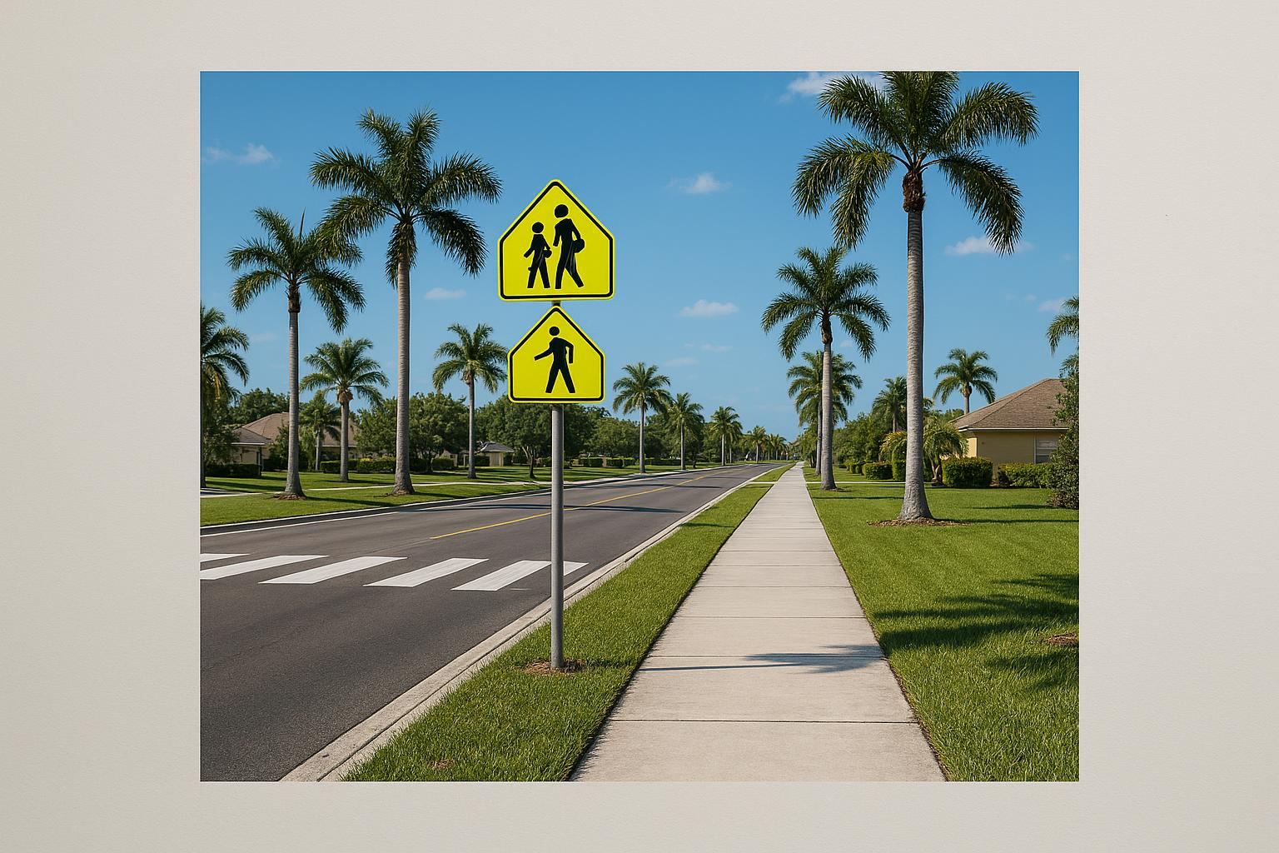

WHAT A SIDEWALK DELIVERS
Benefits for Students
& Community
Safe Walking Path
A separated 5-foot concrete sidewalk protects children from vehicle traffic.
Crosswalk Eligibility
A sidewalk enables installation of a marked crosswalk at the school.
School Zone Signs
With a crosswalk, school zone speed limit signs and flashing beacons can follow.
ADA Accessibility
Provides an accessible route for students and residents with mobility needs.
A sidewalk unlocks the full chain of safety infrastructure for Sunshine Elementary.
Neighborhood Connectivity
Fills a critical gap in pedestrian infrastructure linking homes to the school.

Slide 16
IMPLEMENTATION ASSESSMENT
This Is a Low-Complexity, High-Impact Project
Straight-Line Sidewalk Segment
Standard 5-foot concrete sidewalk, one block, no curves or complex geometry.
Standard Design
No custom engineering required. Uses standard FDOT-compliant sidewalk specifications.
No Drainage Redesign Expected
Preliminary assessment suggests no major drainage modifications required.
No Utility Relocation Expected
Preliminary review suggests utilities will not require relocation.
Right-of-Way Confirmation
Preliminary review indicates sufficient right-of-way.
No additional land acquisition is required. Sara Ave N is a county-maintained road with existing public right-of-way. Clear ROW removes a major barrier to project approval and accelerates timeline.

Slide 17
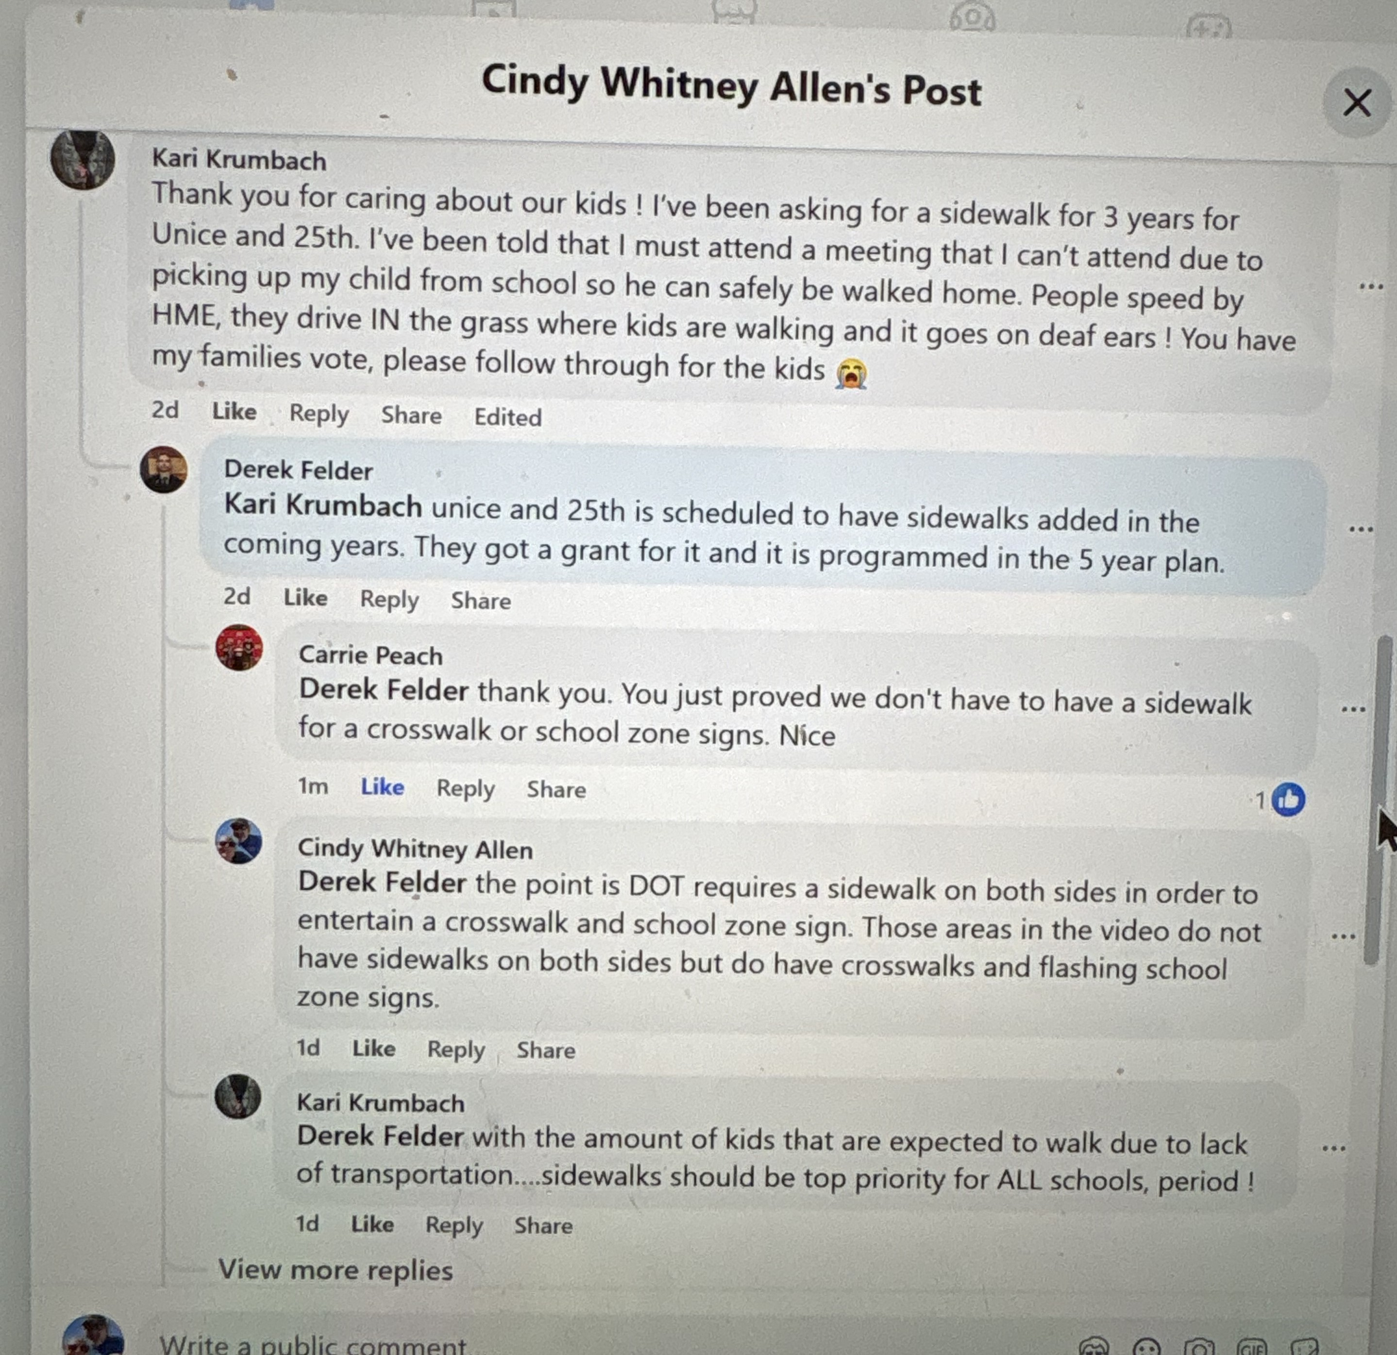
COMMUNITY BACKING
Community Support and Partnership
Community Petition
PTA / Principal Support
131 Signatures
Citizens of Lee County & concerned parents of Sunshine Elementary
Sunshine Elementary Principal Erin Brandao has been a strong advocate for this project and has formally submitted a Facility Modification request through the District Safety Officer for modification of the school property to help parking and traffic flow. Crosswalks and sidewalks were part of the request.
School District Alignment
Organized Parent Advocacy
The Lee County School District’s adopted policy explicitly prioritizes student safety during travel to and from school, directly aligning with the need for pedestrian infrastructure on Sara Ave N.
“Sidewalks and Crosswalks for Sunshine Elementary”
83 Members
Parent-led advocacy group mobilizing community awareness and building sustained public support for pedestrian safety.
Derek Felder — Public Comment
Unice and 25th is scheduled to have sidewalks added in the coming years — funded by a grant and programmed in the 5-year plan.
Context: Response to a social media video highlighting DOT inconsistencies — requiring sidewalks on both sides of the road, a crosswalk, and flashing school zone signs.
Our Partnership Commitment
We are prepared to actively support grant competitiveness through organized community engagement, public advocacy, and any partnership efforts that would strengthen this project’s path to approval and funding.

Slide 18
OUR REQUEST TO THE COMMITTEE
Rank This Project. Fund This Sidewalk.
Protect These Children.
We Are Requesting:
Formal BPAC ranking of this sidewalk project on the BPAC priority list
Inclusion in the next funding cycle for pedestrian infrastructure projects
Direction to Lee County DOT to initiate design and SRTS grant submission
Sara Ave N · 5th St W to 6th St W · Lehigh Acres · Sunshine Elementary · 1,390 Students · ~$25,000
This is happening every single day.
This project is already competitive, fully eligible for funding and ready for implementation.
Thank you for your consideration and commitment to student safety.

