Slide 1
San Carlos Park Florida
Sidewalk Extension to Constitution Circle from Cypress Point Rd to the Clubhouse

Slide 2
San Carlos Park A Census designated Community
Alico Rd

Slide 3
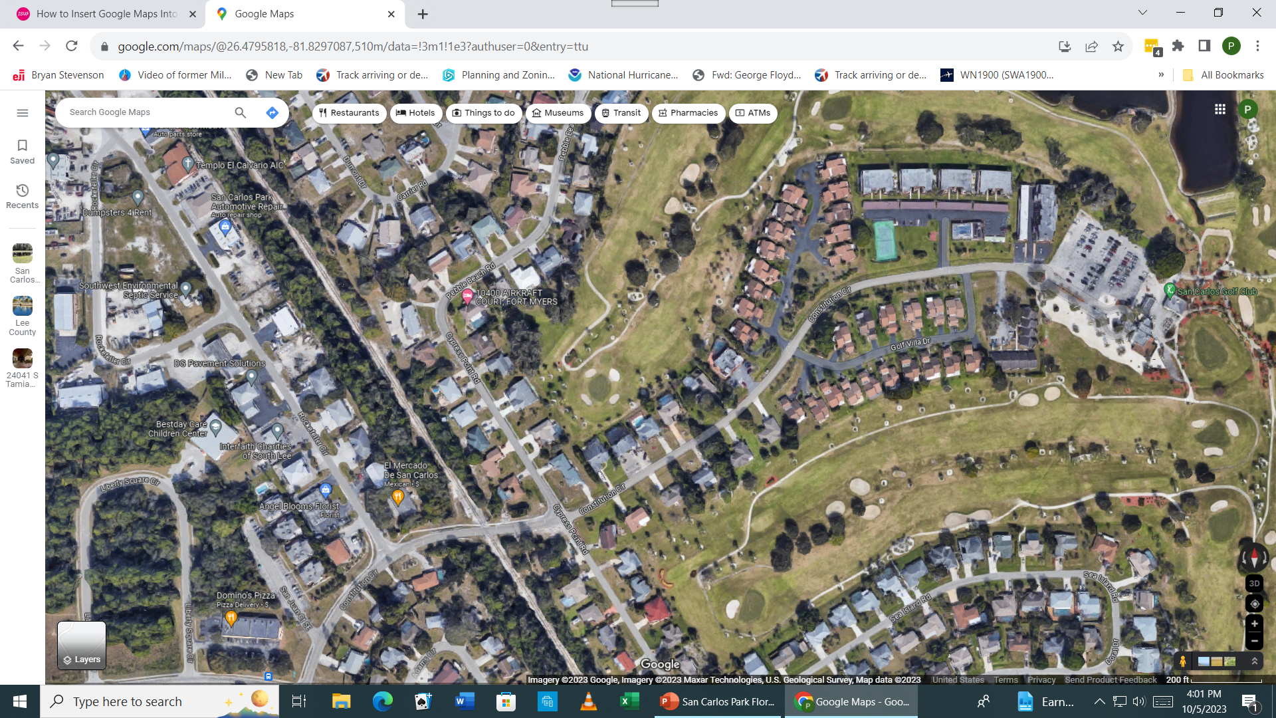
The new Constitution Circle sidewalk will support 34 Homes going west and 6070 homes going east. The length is 0.3 mile

Slide 4
Demographics show a 23.3% of Older and Disabled Residents
6070 Households
Based on the 2020 census
Population 18,563
Total Area 5.0 square miles
65 and older 15.1%
Under 65 with disability 8.2%

Slide 5
Traffic Data is not definitive
Based on data from the General Manager, San Carlos Golf Course sees about 50,000 players per year.
70% play during the November through April period, which averages about 5,834/month. This data does not include non-golf traffic to the Clubhouse.
The Clubhouse has a snack bar and retail facility with golf equipment, clothing, and gifts.
Lee County DOT Data
Lee County DOT completed a mid-block 24hour Speed and volume count on Constitution Cir., East of Cypress Point Rd. in September of 2023.
The daily volume is less than 550 vehicles, with an average speed of 26 miles per hour, with an 85th% speed at 31 miles per hour on this posted 30 mile per hour road.
We conducted a 3-year search of all crashes on this road. Our search revealed 3 total crashes, none of which involved bike or pedestrians, two of the three crashes were single car crashes.

Slide 6
Sidewalks are Funded by Impact Fee money
There are four impact fee districts in Lee County
North, Central, Southwest, and Southeast
Currently, the BPAC Projects are spread among the four Districts as follows:
North – 21 Projects
Central – 90 Projects
Southwest – 9 Projects
Southeast – 2
Today’s Projects would be in these Fee Impact Districts
Barbara Drive – Southwest
Williams Ave. – Central
Oriole Rd, Luckett Rd, Ballard Rd, Daniels underpass – Southwest
Constitution Circle – Southwest
QUESTION - When selecting projects, does the staff recommend from each of the Fee Impact Districts?

Slide 7
What is the BPAC’s Criteria for adding Projects?
Previously – All residents were treated equally with an objective Priority Point System
The Priority Process has been supported by this Committee.
From the minutes:
The Committee Member commented, “We have a formula that encompasses not only citizen support but all the other scoring criteria. His concern was that moving things based on anything other than the scoring criteria affects objectivity.”
“Mr. Giacalone said the Committee has had conversations in the past about high-cost versus lower cost projects and also that there will never to enough money to complete all the projects on the list, but has decided that if a project has merit it should go on the list, should be rated according to the point scoring system and should be considered according to its ranking, regardless of cost.”
What is the process now?

