Slide 1
Oriole Rd
San Carlos Blvd to Alico Rd

Slide 2
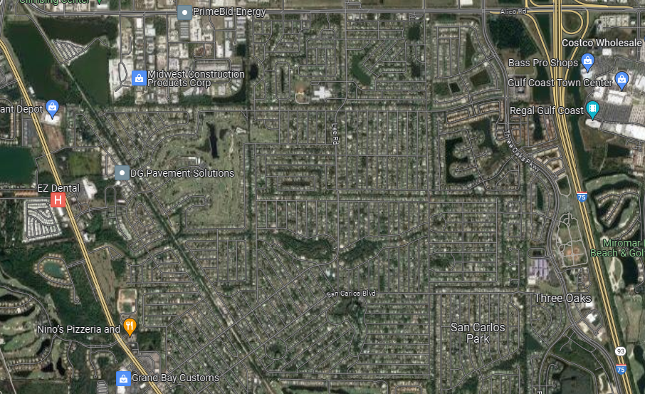
Location Map

Slide 3
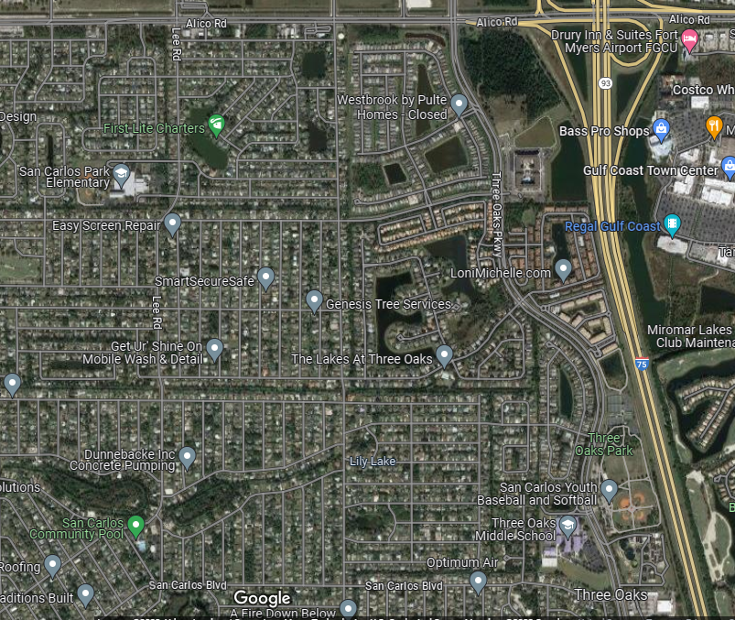
Nearby Facilities

Slide 4
Discussion
Oriole Rd is a collector street
Oriole Rd recently signalized at Alico
  This signal will make Oriole Rd more attractive for local traffic exiting onto Alico Rd
Oriole Rd has 4-foot paved shoulders
Two schools and regional park within a mile of proposed sidewalk
Transit service on Alico Rd and Three Oaks Pkwy
Commercial center being constructed north of Alico Rd

