Slide 1
BPAC Meeting MPO UPDATES
January 17, 2024

Slide 2
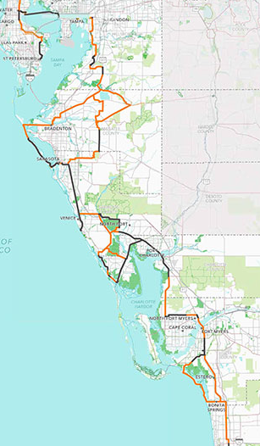

Slide 3
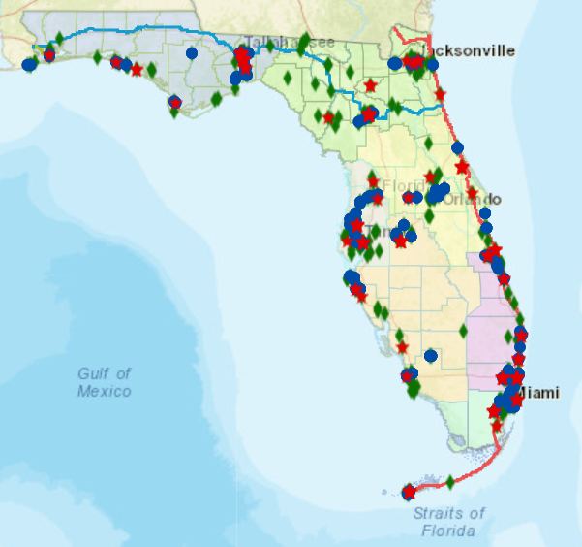
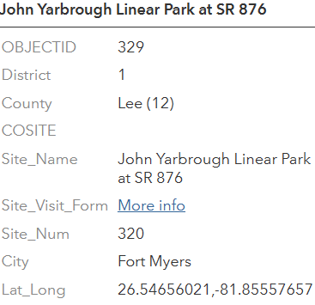
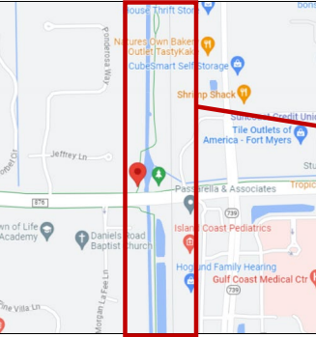
STATUS
Continuous Count Station
Hardware installed
Counter not yet active as there is a software glitch
Counts uploaded in data map monthly

Slide 4
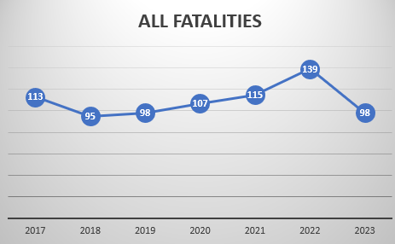
ALL CRASH FATALITIES
109
Source: Signal 4 Analytics

Slide 5
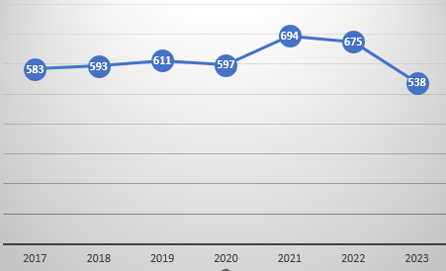
ALL CRASH SERIOUS INJURIES
Source: Signal 4 Analytics

Slide 6
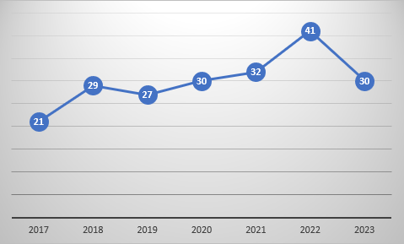
BIKE PED CRASH FATALITIES
34
Source: Signal 4 Analytics

Slide 7
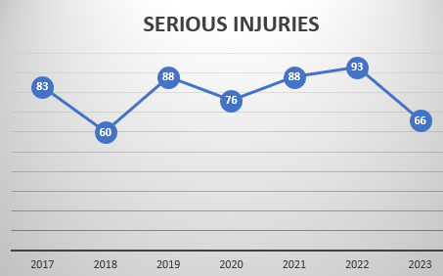
BIKE PED CRASH SERIOUS INJURIES
Source: Signal 4 Analytics

Slide 8
Q&A

