Slide 1
Luckett Rd
Nuna Ave to Hamilton Dr

Slide 2
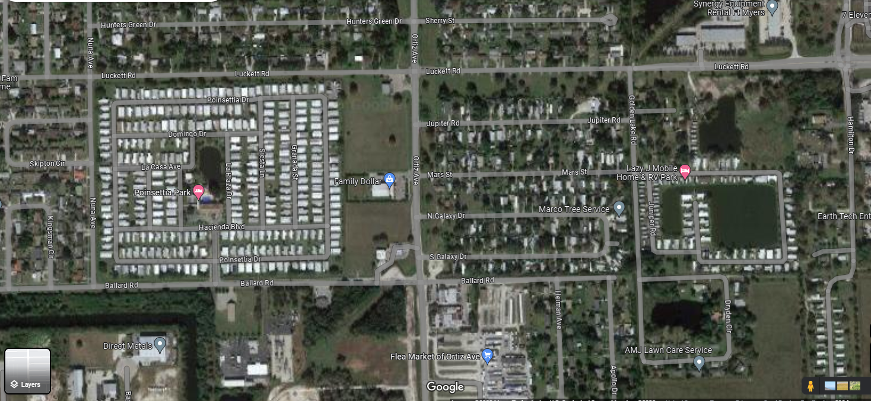
Vicinity Map
Length of project is 0.9 miles

Slide 3
Existing Sidewalks

Slide 4
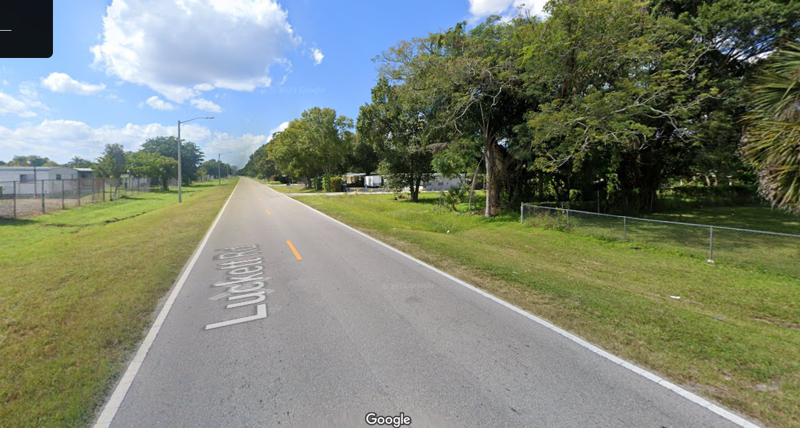
Street View west of Ortiz Ave

Slide 5
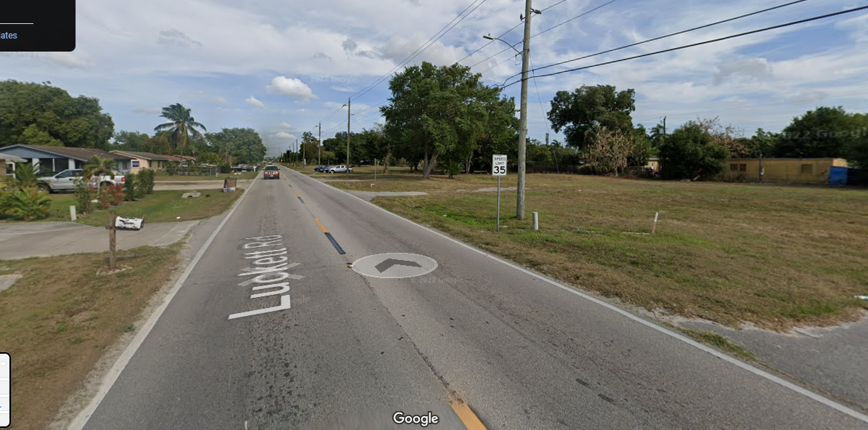
Street View east of Ortiz Ave

Slide 6
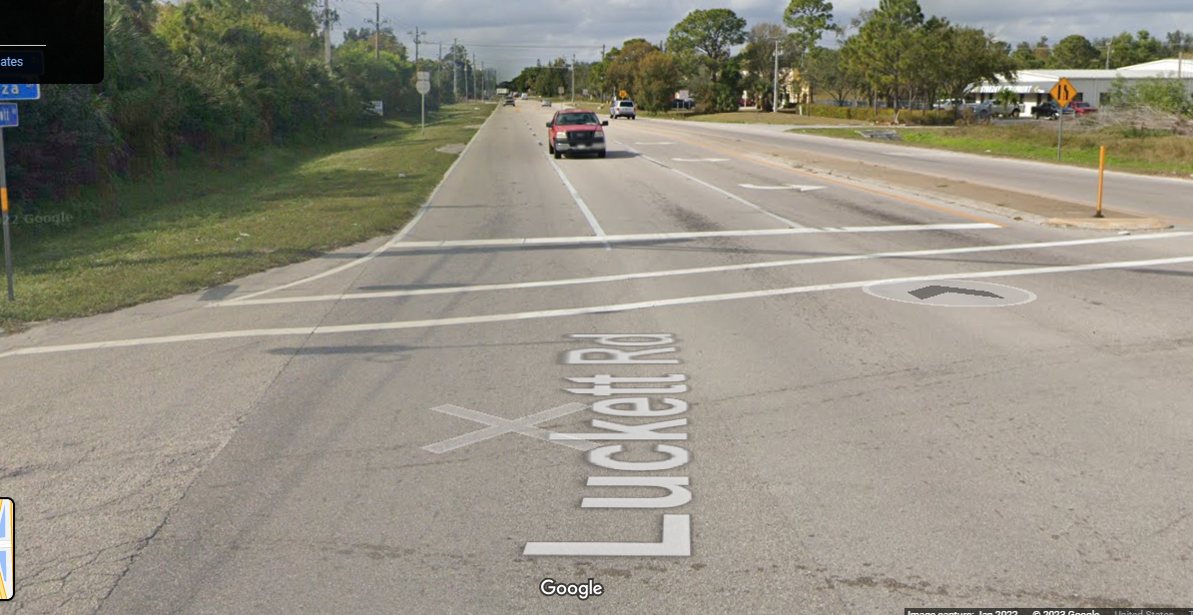
Streetview west of Hamilton Dr

Slide 7
Description
Luckett Rd connects local residents to employment center at Billys Creek Commerce Park
Local community is lower income and highly dependent of foot and bike for transportation
This sidewalk connects transit service along Ortiz Ave to Billys Creek Commerce Park. Transit service into Park is limited
County has ownership of all the right-of-way along the south side of Luckett Rd
Luckett Rd has been removed from first tier construction list
FDOT right-of-way begins several hundred feet west of Hamilton Dr

